Slide 1
THE NEED FOR MENTAL HEALTH OUTREACH IN THE WORKPLACE
Insights from the Open Sourcing Mental Illness Survey
LAURA COOPER, SHRUTI HEGDE AND MONALISA SWAMI

Slide 2
INTRODUCTION
According to the 2010 U.S. National Comorbidity Survey, approximately 18 percent of employed adults had symptoms of a mental health disorder in the previous month.
Research on workplace programs targeting mental health/substance abuse finds that reaching out to workers and expanding benefits may result in more seeking help for mental health/substance abuse issues.
Benefits may include improved employee mood/health, increased productivity, and lower absenteeism in the workplace.
Sources: Harvard Medical School, para 1, 28-29; Lindrooth, et al, 2005, pp. 1092, 1102; Lo Sasso, et al, 2006, pp. 366, 370; Deitz, et al, 2005, p. 313, Lo Sasso, Rost, & Beck, 2006, p. 352.
Notes:
Welcome to our presentation on the need for mental health outreach in the workplace. You are here because you are interested in learning more about common mental health disorders in the workplace and are interested in expanding mental health outreach in your workplace.
TIME = 50 seconds

Slide 3
ABOUT THE DATA
For our analysis, we used the 2016 Open Sourcing Mental Illness dataset. The dataset is a voluntary 2016 survey of those who work in the tech industry. Our analysis includes those who are not self-employed (1,146 entries).
This dataset allows us to learn more about what mental health disorders that are most common among workers, what other companies are doing, and how workers view the role of mental health in the workplace.
Sources: Open Sourcing Mental Illness, LTD, 2016a, 2016b
Notes:
TIME: 30 seconds

Slide 4
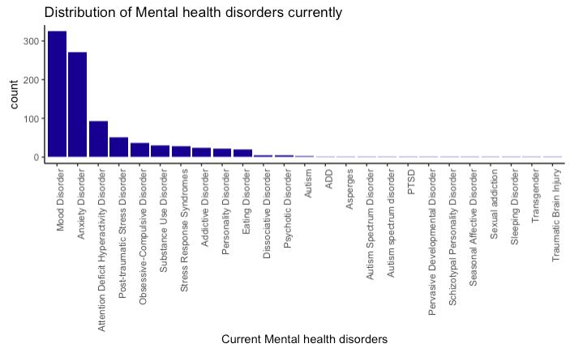
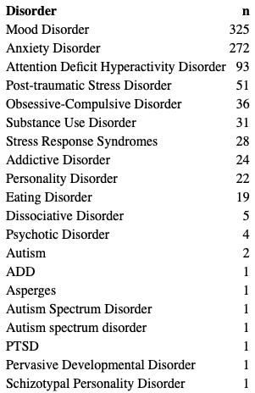
Distribution of Mental Health Disorders
919
Notes:
out of 1146, 919 have been diagnosed with mental health disorder which is quite high , 80% and indicates that it is very much prevalent

Slide 5
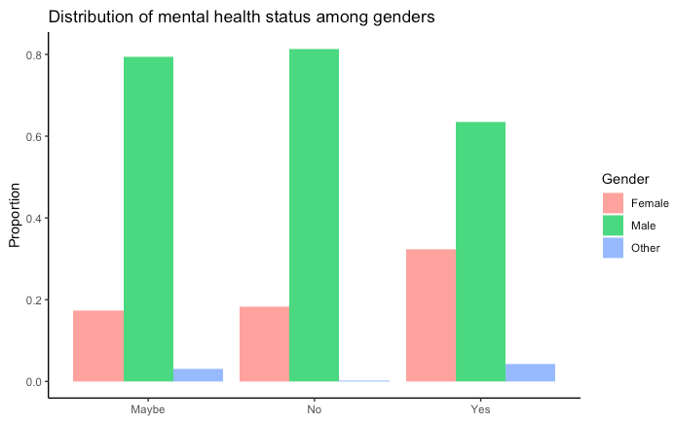
Distribution of Mental Health Status
Notes:
Among the ones that said Yes, 32.3% are females, 63.4% are males and 4.2% are others. Among the people that said No, 81.4% are males, 18.3% are females and 0.2% are others.Among the people that said Maybe, 79.5% are males, 17.3% are females and 3.1% are others.

Slide 6
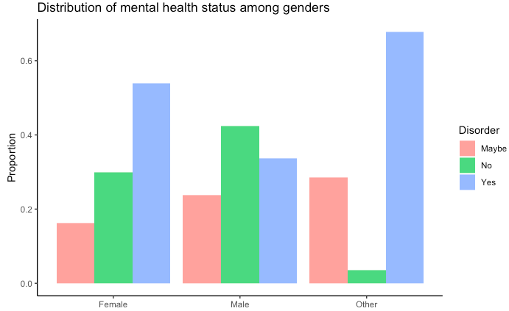
Distribution of Mental Health Status

Slide 7
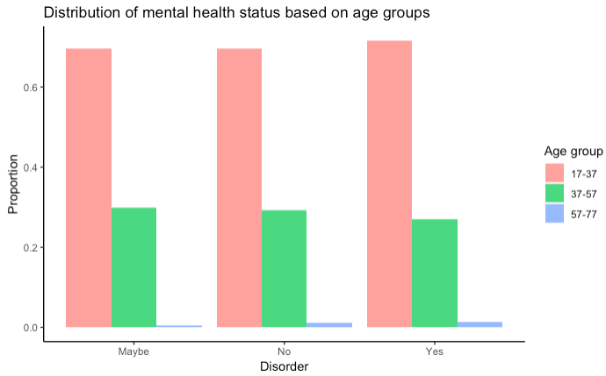
Distribution of Mental Health Status
Notes:
The table and plot above show that among the people that said they have mental disorder currently, 71.6% lie in the 17-37 age group, 27% lie in the 37-57 age group and 1.3% lie in the age group of 57-77. Among the people that said No, 69.6% lie in the 17-37 age group, 29.2% lie in the 37-57 age group and 1.1% lie in the 57-77 group. Among the people that said Maybe, 69.6% liein the 17-37 age group, 29.9% lie in the 37-57 age group and .3% lie in the 57-77 age group.

Slide 8
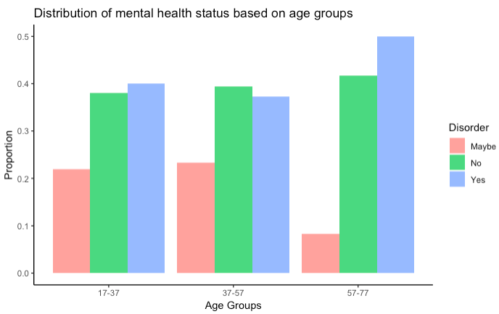
Distribution of Mental Health Status
Notes:
in the age group of 17-37, 40% said they currently have a mental disorder, 38% said they donot have a mental disorder currently and 21.9% said are not sure. In the 37-57 age group, 39.4% said they donot have a mental disorder currently, 37.3% said Yes and 23.2% said maybe or are not sure. In the 57-77 agegroup, 50% said Yes, 41.6% said No and 8.3% said maybe.

Slide 9
Mental Health Policies at the Workplace
Why is it Important?
In 2015, the National Institute of Mental Health estimated that one in five adults in the USA - about 43 million people- lived with a diagnosable mental illness within the previous year and one in 25 had a “serious functional impairment due to a mental illness”
Source: How We Rewrote Our Company’s Mental Health Policy, Harvard Business Review (July 11, 2016)

Slide 10
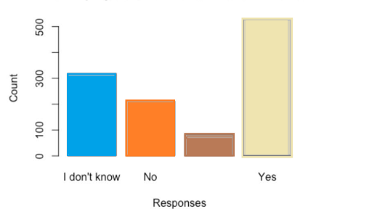
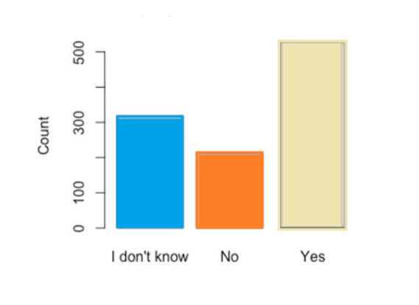
Do Employers Offer Mental Health Benefits?
Notes:
Only 531 out of 1433 companies offered Mental Health Benefits at the workplace., which is almost one-third of the total.

Slide 11
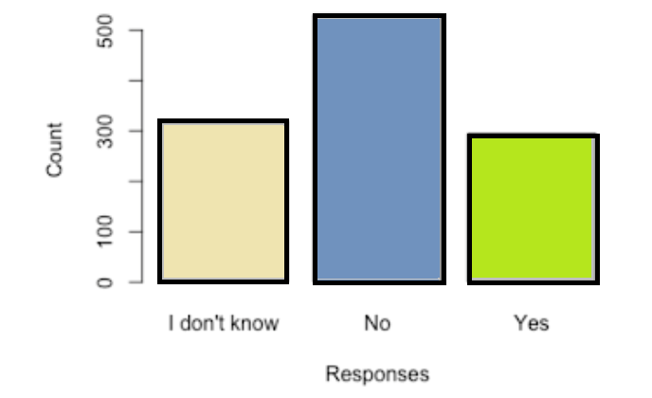
Do Employees Offer Resources to learn about Mental Health?
Notes:
Only 295 out of 1433 companies offer resources to employees to learn more about mental health benefits. 320 out of 1433 respondents responded that they do not know.

Slide 12
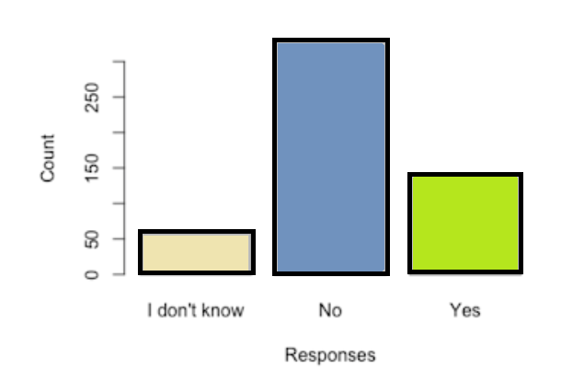
Do Employers Formally Discuss Mental Health?
Notes:
This is for companies that do offer mental health benefits. The question is: do they formally discuss them as part of official communication or a wellness campaign?

Slide 13
WHAT ARE SOME FACTORS THAT MIGHT LIMIT OUTREACH EFFECTIVENESS?
If you are considering starting or expanding mental health outreach in your workplace, it is important to understand some of the factors that might influence the effectiveness of this outreach.
It is important to understand what might influence perception that disclosing a mental health issue would hurt career.
It is also important to understand what might make employees less likely to reach out for help, either through a coworker, supervisor, or by seeking help outside of work (which may require taking medical leave).
Notes:
TIME = 30 seconds
employees perception and what makes them less likely to reach out for help

Slide 14
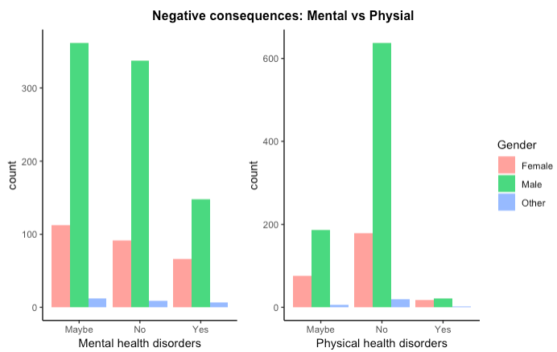
Impact of disclosing a health disorder
Notes:
The figure above shows that majority of people are certain that discussing physical health issues with their employers will not result in negative consequences. Very few believe that discussing physical health issues will have negative consequences. The responses to whether discussing mental health disorders with employers will result in negative consequences is more divided. Some people believe that discussing mental health disorders will have a negative consequence. This is probably due to the stigma at workplace which may make them believe that they might face negative consequences if their mental issues are brought infront of a employer. This will make them less likely to reach out for help, discuss their issues with their employers, take time off work. However, there are still more people who believe there won’t be any negative consequences. This could be because they have already developed a smooth employer-employee relationship. There are comparatively more number of people who are unsure of whether or not there would be any negative consequences if mental health disorders are discussed with their employers.

Slide 15
IMPACT OF EXPERIENCES AT PREVIOUS AND CURRENT WORKPLACE

Slide 16
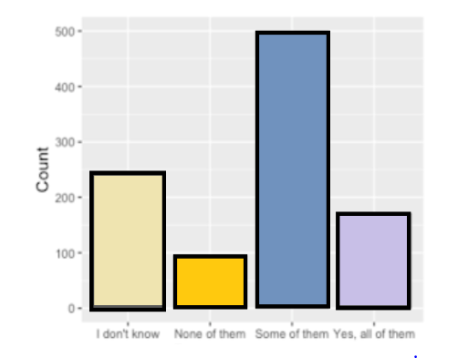
Discussing Mental Health Disorder with Previous Employer Resulting in Negative Consequences.
I don’t know | 245
None of them | 97
Some of them | 501
Yes, all of them | 172

Slide 17
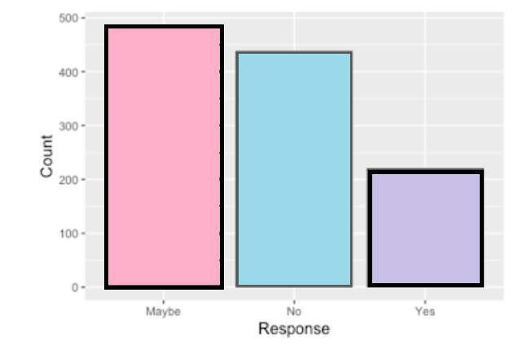
Discussing Mental Health Disorders with Current Employer Resulting in Negative Consequences.
Maybe | 487
No | 438
Yes | 221

Slide 18
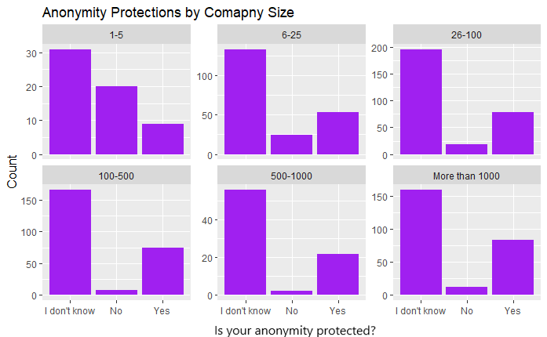
PERCEIVED ANONYMITY POLICIES BY COMPANY SIZE
The finding: Across company sizes, most indicate that they do not know what their current company's anonymity policy is towards those using mental health services.
Notes:
Difference is statistically significant, but with a warning the approximation may be wrong. P value set at .01 instead of .05.
TIME = 40 seconds

Slide 19
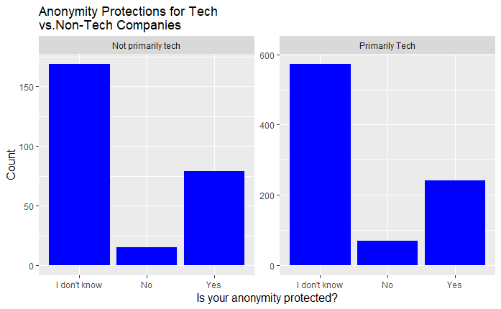
PERCEIVED ANONYMITY POLICIES BY COMPANY TYPE
The finding: In both types of companies, majority indicate that they do not know what their current company's anonymity policy is towards those using mental health services.
Notes:
Difference is not statistically significant. P value set at .01 instead of .05.
TIME = 30 seconds

Slide 20
PERCEIVED EASE OF REQUESTING LEAVE FOR A MENTAL HEALTH DISORDER
We looked at how answers to the question “If a mental health issue prompted you to request a medical leave from work asking for that leave would be?” varied when doing a crosstab table with reported company characteristics and other employee perceptions/experiences.
Used a chi-squared test to measure if there is a potential statistically significant relationship.
Both are categorical variables.
Notes:
We used a chi-squared test on each cross tab to see if it was statistically significant. P value set at .01 instead of .05.
TIME = 25 seconds

Slide 21
PERCEIVED EASE OF REQUESTING LEAVE FOR A MENTAL HEALTH DISORDER
Characteristic | Finding | Sig.?
Gender | “Somewhat easy” is most common answer to req. leave ? across genders. | X
Age Group | “Somewhat easy” most common answer to req. leave ? for 17-27 / 37-57. | X
Company Size | As company size increases, people answer more often that it is easier to request leave (although at 1,000 employees this starts to change).. | ✅
Employer provide mental health benefits? | Those who don’t have mental health benefits say it is somewhat hard to req. leave most often. Those who do say it is somewhat easy most often. | X
Employer ever discussed mental health? | Most common response is somewhat easy to request leave. For those who had a discussion, second most common response is very easy. For those with no discussion, second most common is somewhat hard. | ✅
Employer offer other mental health resources | Most common response is somewhat easy to request leave. For those with other resources, second most common response is very easy. For those without, second most common is somewhat hard. | ✅
Ever seen poor response to mental health issue in the workplace? | Those who did not have an experience most commonly answer that it is very easy to request leave. Those who have most commonly answer that it is somewhat easy or somewhat hard to request leave. | ✅
Notes:
What we found generally is that most employees responding will say that it is somewhat easy to request leave. However, having mental health benefits, discussion on mental health, and other mental health resources may make it more likely that employees would find it easy to request leave (and the reverse). In addition, we find that as company size increases people answer more often that it is easy to request leave (although this may shift starting at 1,000 employees).
TIME: 40 seconds

Slide 22
COMFORT LEVEL IN DISCUSSING A MENTAL HEALTH ISSUE WITH A SUPERVISOR
We looked at how answers to the question “Would you feel comfortable discussing a mental health disorder with your immediate supervisor” varied when doing a crosstab table with reported company characteristics and other employee perceptions/experiences.
Used a chi-squared test to measure if there is a potential statistically significant relationship.
Both are categorical variables.
Notes:
TIME = 30 seconds

Slide 23
COMFORT LEVEL IN DISCUSSING A MENTAL HEALTH ISSUE WITH A SUPERVISOR
Characteristic | Finding | Stat. sig?
Gender | Most respondents across genders indicate that they would be comfortable discussing mental health with supervisor. | X
Age Group | Most respondents 17-37 and 37-57 responded that they would feel comfortable discussing a mental health with supervisor. | X
Company Size | Most respondents working for a company with 1-500 employees say they would be comfortable. Most with 500-1000 employees say maybe. Most with 1000+ say no (but yes is a close second). | X
Ever seen poor response to a mental health issue in the workplace? | Most respondents who haven’t experienced a poor response say they would be comfortable. Those who observed are split across yes, no, and maybe. Those who experienced are split between yes and maybe. | ✅
Do you think discussing mental health disorder with employer would have negative consequences? | Most who responded that they feel that discussing a mental health disorder would have a negative impact are not comfortable discussing a mental health issue with a supervisor. The reverse is also true. | ✅
Notes:
There doesn’t appear to be a statistically significant relationship between gender, age, company size and comfort discussing MH with a supervisor However, there does appear to be a relationship between experience with a poor response in the workplace and perceived negative impact on career and comfort level discussing with a supervisor. It is possible that observing a poor response may have a more harmful impact on disclosure than experiencing it.
TIME = 1 minute

Slide 24
COMFORT LEVEL IN DISCUSSING A MENTAL HEALTH ISSUE WITH COWORKERS
We looked at how answers to the question “Would you feel comfortable discussing a mental health disorder with your coworker” varied when doing a crosstab table with reported company characteristics and other employee perceptions/experiences.
Used a chi-squared test to measure if there is a potential statistically significant relationship.
Both are categorical variables.
Notes:
TIME = 30 seconds

Slide 25
COMFORT LEVEL IN DISCUSSING A MENTAL HEALTH ISSUE WITH COWORKERS
Characteristic | Finding | Stat. sig?
Gender | Across genders the most common response is “maybe.” | X
Age Group | The majority of respondents 17-37 and 37-57 indicated that they might feel comfortable discussing a mental health disorder with coworkers, the second most common response being that they would not. | X
Company Size | Respondents from companies with 1-5 and 6-25 employees are split among yes, no, maybe. For the 26-100, 100-500, and 500-1000 employee companies, most indicate that they maybe comfortable. Respondents from companies with 1000+ employees select “no” the most often. | ✅
Do you think coworkers would view you negatively if knew you had mental health issue? | Think they would be = No is most frequent answer to comfort level question Are viewed negatively = Maybe is most frequent answer, followed by “No” Are not viewed negatively = Yes is most frequent answer. Do not think they would be = Maybe is most frequent, followed by “Yes” | ✅
Ever seen poor response to a mental health issue in the workplace? | Most respondents who haven’t experienced a poor response say they maybe comfortable. Those who observed are split across no and maybe. Those who experienced most frequently say they would be comfortable. | ✅
Notes:
General finding here is that there is not a relationship between gender and age group and comfort level discussing MH issue with coworkers. However, there may be a significant relationship between company size, perception coworkers would view you negatively, and experience with a poor response to MH in the workplace. It is possible that observing a poor response may have a more harmful impact on disclosure than experiencing it.
TIME: 1 minute
Interestingly, those who stated “Yes, I observed” a poor response to mental health in the workplace were evenly split between the maybe and no answers when also asked if they would feel comfortable discussing a mental health disorder with coworkers. However, those who stated that they experienced a poorly handled response selected “Maybe” most often when also asked if they would feel comfortable discussing a mental health disorder with coworkers. The remainder were about evenly split between the “no” and “yes” answers. This may indicate that observing a poorly handled response to a mental health issue in the workplace may have a greater negative effect on willingness to discuss with coworkers than those experiencing it.

Slide 26
TIPS AND SUGGESTIONS
Mental health benefit provision is a first step for mental health outreach. It is also helpful to offer other resources.
If you want to expand outreach in your workplace, here are some suggestions:
Make sure that policies surrounding requesting leave for any medical reason (including mental health) are clear to employees.
Make sure that policies surrounding anonymity of disclosure of mental health issues are clear.
Offer trainings to supervisors and employees on dealing with mental health issues in the workplace.
Review policies to see if they may lead employees to believe that they will be penalized for disclosing a mental health issue or seeking help for one.
Consider anonymous surveys to help determine what problem areas exist.
Notes:
TIME = 1 minute

Slide 27
WORKS CITED
Deitz, D., Cook, R., & Hersch, R. (2005). Workplace Health Promotion and Utilization of Health Services: Follow-up Data Findings. The Journal of Behavioral Health Services & Research, 32(3), 306-319. Retrieved October 21, 2018 from https://doi-org.proxy-um.researchport.umd.edu/10.1007/BF02291830
Harvard Medical School (2010). Mental health problems in the workplace [Newsletter]. Retrieved December 8, 2018, from https://www.health.harvard.edu/newsletter_article/mental-health-problems-in-the-workplace.
Lo Sasso, A. T., Lindrooth, R. C., Lurie, I. Z., & Lyons, J. S. (2006). Expanded Mental Health Benefits and Outpatient Depression Treatment Intensity. Medical Care, 44(4), 366-372. Retrieved October 21, 2018 from https://doi-org.proxy-um.researchport.umd.edu/10.1097/01.mlr.0000204083.55544.f8
Lindrooth, R. C., Lo Sasso, A. T., & Lurie, I. Z. (2005). The Effect of Expanded Mental Health Benefits on Treatment Initiation and Specialist Utilization. Health Services Research, 40(4), 1092-1107. Retrieved October 21, 2018 from https://doi-org.proxy-um.researchport.umd.edu/10.1111/j.1475-6773.2005.00406.x
Lo Sasso, A. T., Rost, K., & Beck, A. (2006). Modeling the Impact of Enhanced Depression Treatment on Workplace Functioning and Costs: A Cost-Benefit Approach. Medical Care, 44(4), 352-358. Retrieved October 21, 2018 from https://doi-org.proxy-um.researchport.umd.edu/10.1097/01.mlr.0000204049.30620.1e
Meyer, K. (2016). How We Rewrote Our Company’s Mental Health Policy. Harvard Business Review. Retrieved December 13, 2018 from https://hbr.org/2016/07/how-we-rewrote-our-companys-mental-health-policy.
Milne, S. H., Blum, T. C., & Roman, P. M. (1994). Factors Influencing Employees Propensity to Use an Employee Assistance Program. Personnel Psychology, 47(1), 123-145. Retrieved October 24, 2018 from http://search.ebscohost.com.proxy-um.researchport.umd.edu/login.aspx?direct=true&db=bth&AN=9411113184&site=ehost-live
Open Sourcing mental Illness, LTD (2016a). OSMI (Version 1) [Data file]. Retrieved September 7, 2018, from https://osmihelp.org/research
Open Sourcing Mental Illness, LTD (2016b). osmi-survey-2016_1479139902 [Metadata File]. Retrieved September 19, 2018, from https://osmihelp.org/research.

Slide 28
Thank You

